Slide 1

Patch management in ConfigMgr Notes from the field
Peter Löfgren
@LofgrenPeter
Senior Technical Architect

Slide 2

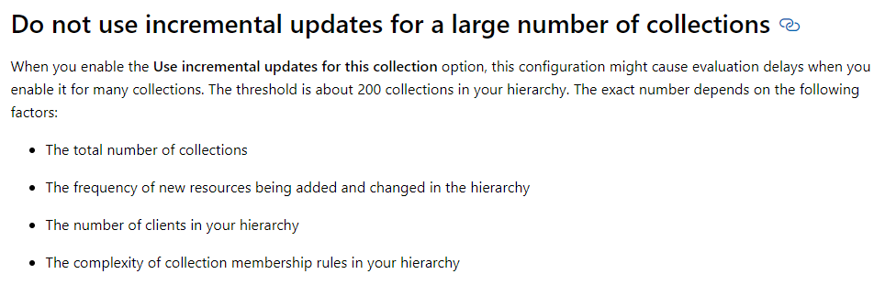
Collections
Servers vs clients
Limiting collections!
Dedicated collections for software updates

Slide 3
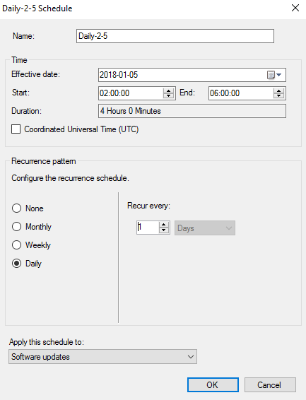
Maintenance Windows
Control, control & control!
Servers vs clients
Make sure there is enough time!
Don’t forget about MS Defender

Slide 4

Client Settings
Configure WSUS settings
Configure Restart settings
Configure Deadline settings
_ALWAYS_ use custom device settings!

Slide 5
Demo

Slide 6
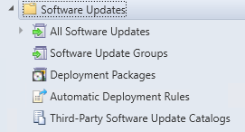
Moving Parts
Deployment Packages
Software Update
Software Update Groups

Slide 7
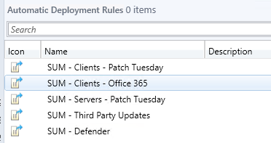
Automatic Deployment Rules
Number of ADRs
Content of ADRs
Deployment Packages

Slide 8
Demo

Slide 9
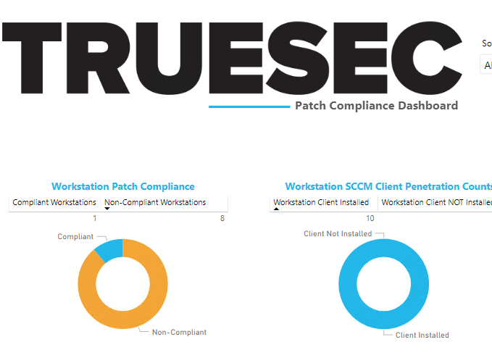
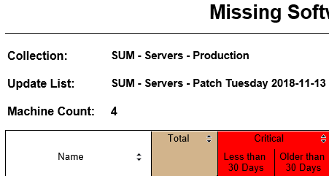
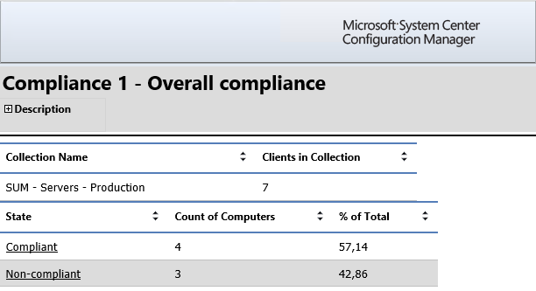
Reporting
Built-in Reports
Custom Reports
PowerBI

Slide 10
Demo

Slide 11

Slides and demos from the conference will be available at
https://github.com/nordicinfrastructureconference/2019

